Slide 1
The PUZZLE is incomplete without “U”
Tanya M. Blackwell, Contracting Officer, Office of Sponsored Programs (OSP)
April 28, 2015

Slide 2
Imagine…
…a university with innovative and research driven engineers and scientists, devoted to the advancement of knowledge and serving the public interests
...supported by departmental leadership and administrative staff that is trained and skilled in the policies and procedures surrounding sponsored research
…cooperating with a contracting entity that oversees the process from start to finish to ensure compliance at institutional, state, and federal levels
…continuously receiving sponsored research from industry, state, and federal agencies and maintains its place as a leader in the engineering and scientific research community.

Slide 3
Agenda
Covering the 5 W’s of GTRC and NSF Proposals/Awards
Introduction
When All the Pieces Come Together Explains the puzzle analogy with respect to sponsored research and its administration
Who
Who’s Who at Georgia Tech Research Corporation (GTRC) Will provide a brief overview of important contacts with handout for future reference.
What
NSF Grants From Conception to Completion Discusses the entire life of an NSF award, beginning with finding funding, proposal submission, award management, extensions, and close-out.
When
There’s a Time for Everything… Reviewing the life span of an NSF award, highlight important timelines for PI and OSP actions and requests.
Where
And a Place for Everything too! Discusses where PI and OSP actions and requests happen (Fastlane)
and provides information on where to find resources and tools.
Why and Closing
The Big Picture
Concluding with the puzzle analogy, presents the result of our
successful administration of sponsored research with the NSF.

Slide 4
Who’s Who at GTRC
The Georgia Tech Research Corporation (GTRC) is the contracting agency for all sponsored research activities at Georgia Tech. There are many offices and departments to assist you with every aspect of your sponsored research activities. Today’s focus is on sponsored research with the National Science Foundation (NSF), but below is a brief overview of GTRC and the important office and contacts.
Georgia Tech Applied Research Corporation (GTARC)
501 (c)(3) not-for-profit organization
Serves as the contracting entity for GTRI
GTARC is to GTRI as GTRC is to Georgia Tech
Collaborations with GTRI should be handled through this office (interdivisional transfers)
Conflicts of Interests Management Office
helps manage conflict of interest issues that may arise from institutional, faculty, and staff relationships with external organizations
ensures timely and effective reporting as required by federal regulations and university policies
Office of Industry Engagement
promotes partnerships with industry, government, and non-profits
serves as a one-stop shop for anyone interested in pursuing strategic collaborations through sponsored research, international research, licensing, and new venture agreements.

Slide 5
Who’s Who at GTRC
Office of Research Integrity Assurance (ORIA)
Promotes responsible conduct of research
Collaborates with PIs and departments on sponsored research that involves human subjects, the use of animal models, the application of export controls, compliance with the conflicts of interest policy, and administration of recombinant DNA regulations.
Depending on function, process goes through different department of this office at different times
Office of Sponsored Programs (OSP)
manages all pre-award and non-financial post-award matters for externally sponsored grants and contracts
broken up into teams by sponsors
works with every other office within GTRC and other offices across campus to facilitate all sponsored research needs.
Other Important Offices
Grants and Contract Accounting
Environmental Health and Safety

Slide 6
Conception to Completion: where “U” fit in
Expanding upon “Cradle to Grave” research administration
Conception
Cradle and life
grave and afterlife
Completion
Finding funding (aligning research goals with sponsors’ missions and requests for proposals)
Understanding different award mechanisms and when each should be used
Working with PIs and OSP to submit proposal
Receiving a new award from sponsor
Accepting transfer in from another university
Managing post-award financial obligations
Managing non-financial post-award functions
Transferring to another University
Changing PI on project
Requesting extensions
Completing Close-Out
Submitting final reports

Slide 7
NSF Grants: Conception
Have an idea but need funding???
The NSF is a great place to start looking
The NSF funds most research and education in engineering and the sciences.
It accomplishes this through grants and cooperative agreements (as well as fellowships)
It is responsible for ¼ of federal support to universities and institutions of higher learning.
It receives approximately 44,0000 proposals each year; it funds roughly 11,000 (~25%) of them.
The NSF offers several funding mechanisms that can suite your needs
Solicited interdisciplinary programs
Areas of national importance
Center competitions
Education and training (fellowships)
Workshops, conferences, and symposiums

Slide 8
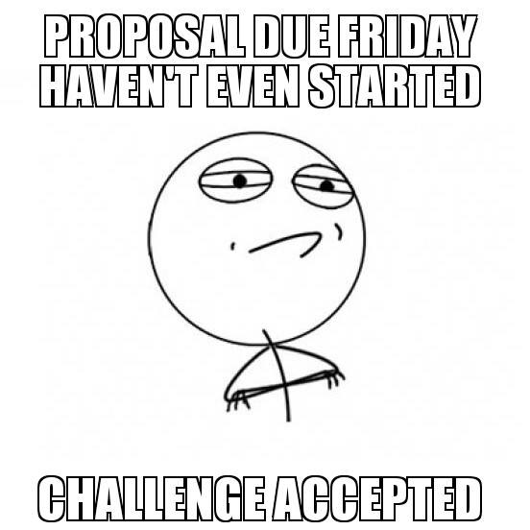
Conception
Successfully submitting proposal through OSP
Complete Routing Package
First sheet of routing form – verify for accuracy (can hold things up at award stage)
Second page of routing form – ensure appropriate signatures
Third page of routing form – RCR (when students are on the project)
Scope of Work: doesn’t need to be long, but comprehensive
Budget and Justification – accurate and reflects the right/current fringe and F&A rates
Work with contracting officer from the beginning (be liaison)
Provide intent to submit, RFP file or link, deadline
Consider his/her workload
Keep the lines of communication open
Submission of Proposal
Review before sending to contracting officer
Give enough time for review and technical difficulties

Slide 9
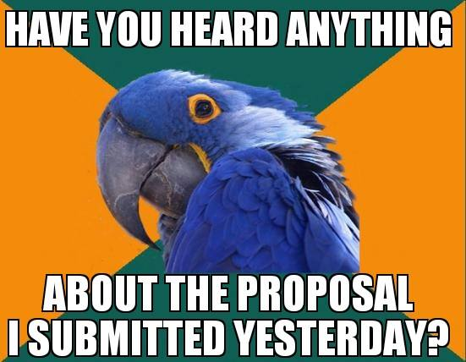
Pregnancy
After proposal submission (before the award)
What happens at Georgia Tech
Compliance matters (IRB, IACUC, EHS)
ICOL (check for accuracy)
Proposal Withdrawal
“Patience is a virtue.”

Slide 10
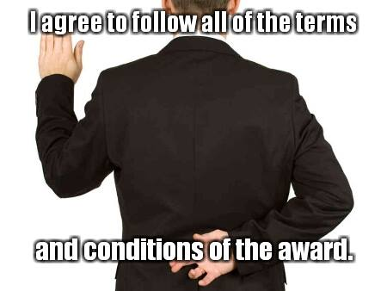
Labor and Delivery
The moment we’ve all been waiting for…
AWARD LETTER!!!
Terms and Conditions
OSP process and possibilities for delay
Verifying information
It’s an…..

Slide 11
Taking Care of Baby
While you do the research, we’ll do the administration
Grants and Contracts Accounting
Post-Award Financial Functions
Office of Sponsored Programs (OSP)
Post-Award Non-Financial Functions
Establishes award number and project
Establishes award in system (requests project number from Grants and Contracts)
Submits financial reports to sponsor
Oversees expenditures and ensures costs are allowable
Processes cost transfers when necessary
Requests budget revisions when necessary
Manages project accounting
Creates subprojects where necessary
Sets up cost-share accounts also
Bills sponsor for payment/reimbursement
Responsible for data entry for project information (including budget) and scanning of award documents
Creating subawards when necessary
Oversees compliance matters
Corresponds with sponsor when necessary
Processes incremental and supplemental funding
Manages deliverables
Processes extensions
Accepting an award comes with great responsibilities, by way of the terms and conditions. While PIs focus on their research, the Office of Grants and Contracts Accounting and the Office of Sponsored Programs are here to assist with helping you take care of administrative needs. Be mindful, however, that we manage hundred of grants and the level of service we can provide is contingent upon constant communication, transparency, and PI stewardship.

Slide 12
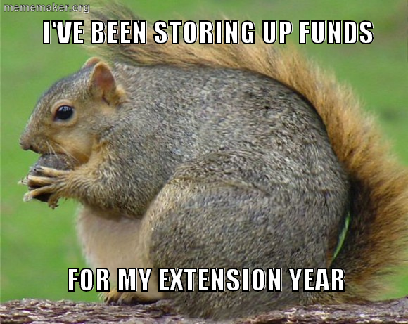
“It’s so hard to say goodbye…”
…and sometimes, you don’t have to (yet)
Transferring award to another university (that you’re going to)
Transferring award to another PI
No-cost Extension (NCE): Grantee Approved or NSF Approved

Slide 13
Completion
When it’s all said and done
With just a few final touches, the last pieces to put into places…
These are the matters that, in addition to great research and innovation, increase our chances for future funding.
Final Project Reports
Close-Out
Project is terminated, but records are kept and maintained
Submitted to sponsor and approved
Completion of all Financial Matters and Reports Submitted
Working with G&C Accounting in timely manner

Slide 14
There is a time for everything…
A brief look at the timeline for NSF grants
Pre-Award Function | When to Submit
Intent to Submit Proposal | ASAP
Routing Form (without signatures) | By review
Edit/Review Access in Fastlane | 3 business days before deadline
FULL Submit Access in Fastlane | 24 hours before deadline
Proposal File Update (revisions) | Before deadline
Routing Form (complete signatures) | Before logged

Slide 15
There is a time for everything…
A brief look at the timeline for NSF grants
Pre-Award Function (continued) | When to Submit
Proposal File Update (with approval) | By timeline given
Review for IRB/IACUC approval | After submission, ASAP
Review for EHS approval | After submission, ASAP
Review for Export Controls | ASAP at award
Revised Budget | ASAP
Advanced Number Request (90 pre-award spending) | When award in soon forthcoming

Slide 16
There is a time for everything…
A brief look at the timeline for NSF grants
Post-Award Function | When to Submit
Subaward Request | ASAP when you receive award
Annual Project Report | 90 days before budget period ends
RCR/Ethics Training (both CITI online training *AND* in-person requirements, for projects that have ANY students working on them) | 90 days or end of the semester (whichever is later)
Final Project Report | 90 days after expiration of grant
Project Outcomes Report | 90 days after expiration of grant
Grantee Approved NCE | 10 days before end
NSF Approved NCE | 45 days before end

Slide 17
And a Place for Everything too!
Summarizing where to perform pre- and post-award functions
Pre-Award Function | Where/How to Submit
Intent to Submit Proposal | Email or call to CO
Routing Form (without signatures) | Email to CO
Edit/Review Access in Fastlane | Fastlane (allow SRO access)
FULL Submit Access in Fastlane | Fastlane (allow SRO access)
Proposal File Update (revisions) | Fastlane (Proposal Functions)
Routing Form (complete signatures) | Email to CO

Slide 18
And a Place for Everything too!
Summarizing where to perform pre- and post-award functions
Pre-Award Function (continued) | Where/How to Submit
Proposal File Update (with approval) | Fastlane (Proposal Functions)
Review for IRB/IACUC approval | Research Integrity Assurance
Review for EHS approval | Submitted by CO to Debbie
Review for Export Controls | Research Integrity Assurance
Revised Budget | Fastlane (Prposal Functions)
Advanced Number Request (90 pre-award spending) | Complete and submit form to CO with signatures

Slide 19
And a Place for Everything too!
Summarizing where to perform pre- and post-award functions
Post-Award Function | Where/How to Submit
Subaward | WebWise (approval in Fastlane if not originally proposed)
Annual Project Report | Research.gov
RCR/Ethics Training (both CITI online training *AND* in-person requirements, for projects that have ANY students working on them) | Documentation provided and maintained by OSP
Final Project Report | Research.gov
Project Outcomes Report | Resesarch.gov
Grantee Approved NCE | Fastlane
NSF Approved NCE | Fastlane

Slide 20
Why and Closing
Graphical representation of how we perform among peers

Slide 21
Questions and Answers
What would you like to receive from GTRC, OSP, and/or your contracting officers?
What resources are important to you?
How can we improve our customer service?

